Slide 1

AL-Go for GitHub Office Hours call
January 2025

Slide 2
Agenda
What’s new
Open discussion / Q&A

Slide 3
What’s new in AL-Go for GitHub
V6.3 was released
ConditionalSettings based on buildMode
Preprocessor symbols
No more thisbuild artifacts
New versioning strategy
DEMO Repo:
https://github.com/BusinessCentralApps/AL-Go-OfficeHours-2025-1

Slide 4
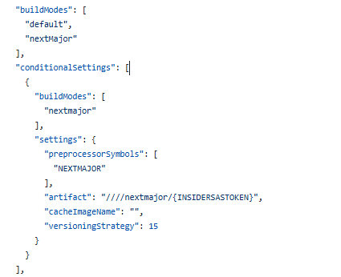
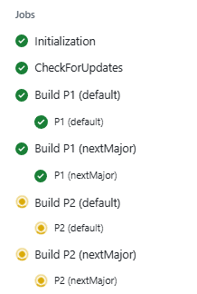
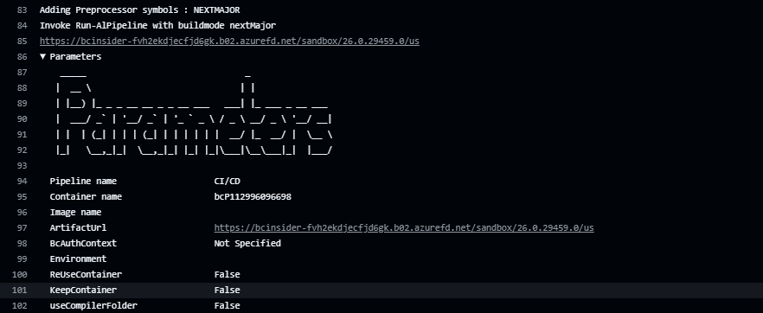
ConditionalSettings on buildmode Preprocessor symbols

Slide 5
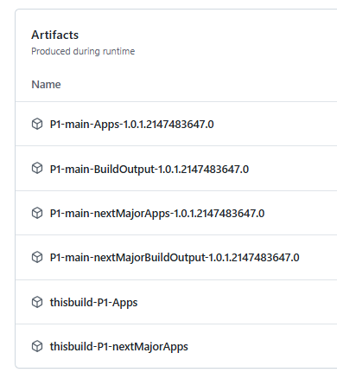
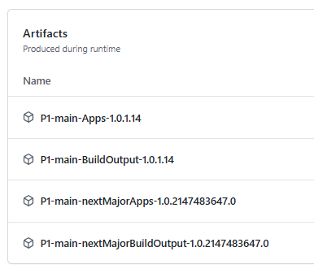
No more thisbuild artifacts
Before
After

Slide 6

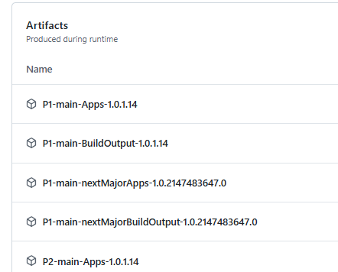
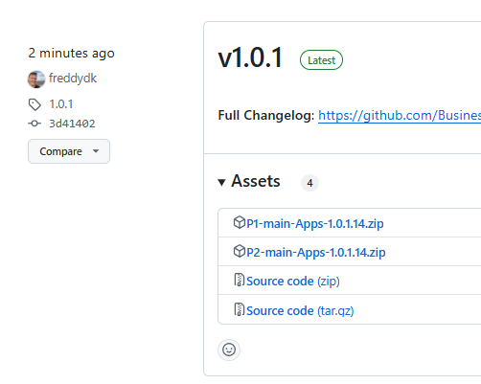

New versioning strategy - #3

Slide 7
Open discussion Q&A

